Slide 1
Better health and fun at work!

Slide 2
Join this springs most motivating activity campaign
Type in the name of the competition here
Competition period XX XXX – XX XXX (add the dates here)

Slide 3
Teamwork
Each participant creates their own profile. Once you have created a profile, you can create teams, we recommend 2-8 members. Are you more than 8 people? Create more teams! Together you work to reach the goal in time.
All activities count
The goal is to keep a daily step average of 10,000 steps throughout the competition period. All steps you take and all activity you register are counted in your step average. Your steps are transferred automatically with our app and you can easily register other activity in the activity table.
Follow the progress
Follow your own and the progress of your colleagues’ in the virtual map. By registering all your activity, you will get closer to the goal. Everyone who participates will be able to follow each other in the top lists and in the virtual map.

Slide 4
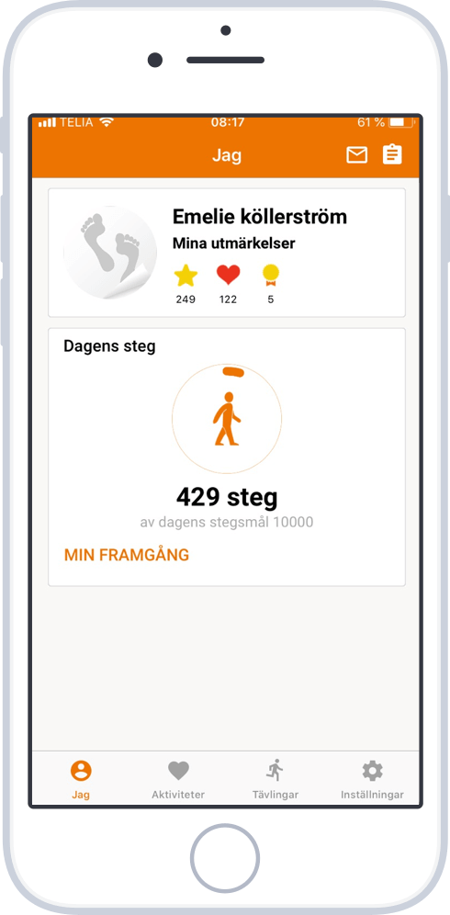
This is how it works
Download the Tappa PRO app and get a full overview.
Your steps are automatically registered by our app.
If you do other activities, you can easily register these in the activity table.
Once you have registered activity, you can follow your and the team’s progress in the map and in the top lists.
If you want to count your steps in a different way than the app, you can use manual pedometers or your own watch from Fitbit, Polar or Garmin. Choose what suits you best!
Download Tappa Pro
New: Tappa's app is now downloading steps from Apple Health and Google Fitness. You can therefore use all activity wristbands that can be connected to these, e.g., Apple Watch.

Slide 5
How to get started
Download the app- "Tappa Pro".
Register a profile or log in with your existing username
Type in the startcode: XXXX (type in your startcode here)
Ps. If you prefer to register via the web, you can easily go to www.tappa.se/reg and enter the start code. Then you register a user.
Questions? Contact Tappa at: info@tappa.se or 0340-676 676

